Slide 1
Eric Haas, Health eData Inc. and Brett Marquard, WaveOne
Argonaut: USCDI + US Core

Slide 2

Instructor
Eric Haas
President Health eData Inc
Argonaut SME
Da Vinci SME
Primary Editor, Argonaut Data Query IG / US FHIR Core IG
ehaas@healthedatainc.com
Notes:
Slides available on whova after.

Slide 3

Instructor
Brett Marquard
Principal, WaveOne Associates
Extensive EHR experience
Primary Editor, Argonaut Data Query IG / US FHIR Core IG
Argonaut Project Manager
brett@waveoneassociates.com
Notes:
Slides available on whova after.

Slide 4

21st Century Cures Act: Interoperability, Information Blocking, and the ONC Health IT Certification Program
The patient is at the center of the 21st Century Cures Act. Putting patients in charge of their health records is a key piece of patient control in health care, and patient control is at the center of HHS' work toward a value-based health care system.
The ONC Cures Act Final Rule implements interoperability requirements outlined in the Cures Act. Patients need more power in their health care, and access to information is key to making that happen.
…in the rule…
Considering this and commenters' recommendations, we have adopted the HL7 FHIR US Core Implementation Guide STU 3.1.0 (US Core IG) implementation specification in § 170.215(a)(2). We note that we adopted the latest version of the US Core IG at the time of the final rule publication. The US Core IG defines the minimum conformance requirements for accessing patient data using FHIR Release 4 (adopted in § 170.215(a)(1)), including profiled resources, operations, and search parameters for the Data Elements required in the USCDI implementation specification (adopted in § 170.213)
..
https://www.federalregister.gov/d/2020-07419/p-1177

Slide 5
Outline
US Core and the Argonauts
Importance of Profiles
US Core Profiles
US Core vs USCDI
Future
Notes:
Make clear slides ‘borrowed’ from Josh/Eric/Micky/other members of argo

Slide 6
What is the Argonaut Project?
The Argonaut Project is an implementation community comprising leading technology vendors and provider organizations to accelerate the use of FHIR and OAuth in health care information exchange.
We are:
Private sector initiated and funded
Working collaboratively with other FHIR initiatives such as SMART-on-FHIR, and the Health Systems Platform Consortium (now Logica!)
Creating open industry Implementation Guides in high priority use cases of importance to patients, providers and the industry as a whole
We are NOT:
A standards development organization
A separate legal entity
A proprietary activity

Slide 7

Technology Vendors | Provider Organizations
Accenture | Beth Israel Deaconess Medical Center
Allscripts Apple | Intermountain Health
 | Mayo Clinic
Athenahealth | Partners Healthcare
Cerner | SMART at Boston Children’s Hospital
Change Healthcare
eClincialWorks
Epic
Humana
MEDITECH
Microsoft
Optum
Surescripts
Staff (current and past)
Prime contractor: HL7
FHIR initiatives: Grahame Grieve, Eric Haas, Josh Mandel, Brett Marquard, Gino Canessa, Carl Anderson
OAuth initiatives: Dixie Baker, Josh Mandel
Project Management: Brett Marquard (Jennifer Monahan, Micky Tripathi prior to 2021!)

Slide 8
The Argonaut process helps resolve practical problems
What search criteria can you use?
What type of data will you get in response?
How will that data be represented?
Search operations
Examples:
Can search for individual patient by identifier (e.g., MRN) OR full name & gender OR full name & birthdate
Can search for Procedures by patient or by patient & specified date range
Scope of response
Examples:
Search for patient will get all FHIR patient resources
Search for Procedures will get all current and historical procedures or within specified date range
Content of response
Examples:
Patient search will get name, identifier, gender, birthdate,
Procedures search will get type of procedure, date performed, and procedure status
In some cases created extensions and value sets
7

Slide 9
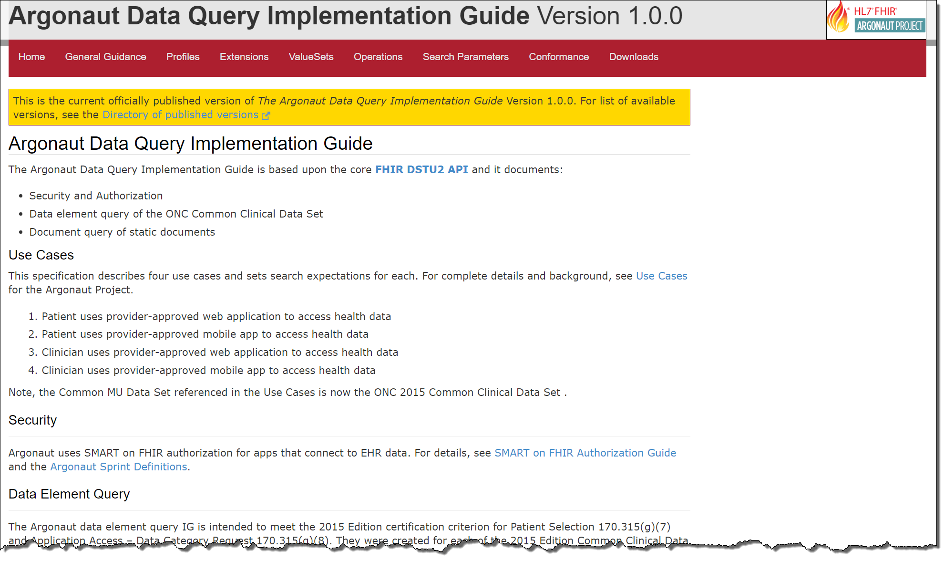
The Signature Event: Argonaut Data Query Implementation Guide
Access to individual data elements of Common Clinical Data Set
Access to structured document (CCD) containing all Common Clinical Data Set elements
Leverage OAuth2-based security and authorization
http://www.fhir.org/guides/argonaut/r2/

Slide 10

US FHIR Core
The US FHIR Core is a labeled subset of all HL7 US Realm produced FHIR profiles.
The label is designed to provide the community with a single point of reference to foundational US FHIR profiles that:
should be used by US stakeholders when implementing FHIR; and
be the basis for creating further US Realm profiles.
Bottom line
Argonaut IG = US Profiles on FHIR DSTU2, and FHIR R4
US Core = HL7 balloted US Profiles. Built from Argonaut requirements. Versions built for FHIR STU3/R4.
…fun fact: the Data Access Framework (DAF) = ONC sponsored DAF effort on FHIR preceded the Argonaut guide!
Notes:
WORKFLOWS
- Patient
- Provider
- Payer
….rest.documents..

Slide 11
Argonaut DSTU 2 vs US Core Profiles
Argonaut DSTU 2
Argonaut AllergyIntolerance Profile
Argonaut CarePlan Profile
Argonaut CareTeam Profile
Argonaut Condition Profile
Argonaut Device Profile
Argonaut DiagnosticReport Profile
Argonaut DocumentReference Profile
Argonaut Goal Profile
Argonaut Immunization Profile
Argonaut Medication Profile
Argonaut MedicationOrder Profile
Argonaut MedicationStatement Profile
Argonaut Observation Results Profile
Argonaut Patient Profile
Argonaut Procedure Profile
Argonaut Smoking Status Observation Profile
Argonaut Vital Signs Observation Profile
US Core STU3.1.0 (based on FHIR R4)
US Core AllergyIntolerance Profile
US Core CarePlan Profile
US Core CareTeam Profile
US Core Condition (a.k.a Problem) Profile
US Core Device Profile
US Core DiagnosticReport Profile for Laboratory Results Reporting
US Core DiagnosticReport Profile for Report and Note exchange
US Core DocumentReference Profile
US Core Encounter Profile
US Core Goal Profile
US Core Immunization Profile
US Core Laboratory Result Observation Profile
US Core Location Profile
US Core Medication Profile
US Core MedicationRequest Profile
US Core MedicationStatement Profile
US Core Organization Profile
US Core Patient Profile
US Core Pediatric BMI for Age Observation Profile
US Core Pediatric Weight for Height Observation Profile
US Core Pediatric Head Occipital-frontal Circumference Percentile Profile
US Core Practitioner Profile
US Core PractitionerRole Profile
US Core Procedure Profile
US Core Provenance Profile
US Core Smoking Status Profile
Vital Signs Profile (FHIR Core Profile)
10
Notes:
RESOURCES+PROFILES!

Slide 12
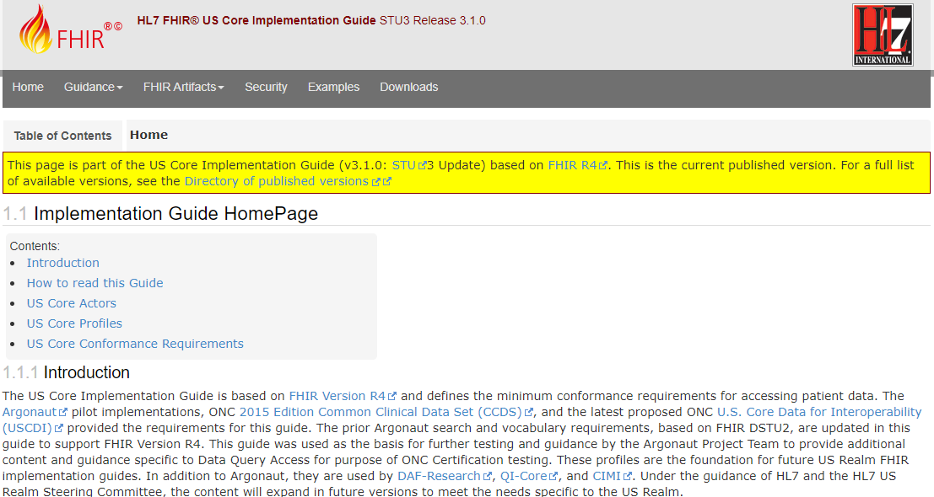
Key Components – Data Query
General Guidance
FHIR Artifacts:
Profiles*
Extensions
Value Sets
Operations
SearchParameters
Conformance
Notes:
This guide spends a lot of time on Structure and Search – therefore lots of focus on the Profiles

Slide 13
Profile-less FHIR
You don’t need profiles to interoperate with FHIR
Resources are “discrete” enough that mechanism to populate most elements is clear
Approach
Populate/consume all elements you know, use HL7 or country-standard extensions for extras
Map to/from “recommended” terminologies as much as possible, populate CodeableConcept.text
Expose capabilities in Conformance resource
Notes:
With profile, they can interoperate ‘ok’.

Slide 14
Profile-less FHIR
You don’t need profiles to interoperate with FHIR
Resources are “discrete” enough that mechanism to populate most elements is clear
Approach
Populate/consume all elements you know, use HL7 or country-standard extensions for extras
Map to/from “recommended” terminologies as much as possible, populate CodeableConcept.text
Expose capabilities in Conformance resource
Notes:
With profile, they can interoperate ‘ok’.

Slide 15
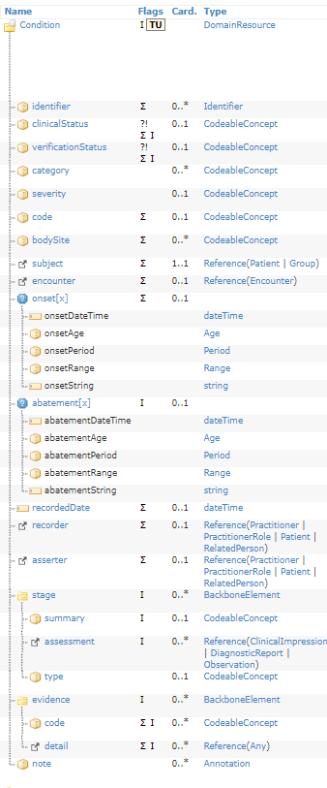
Base Condition Resource vs.

Slide 16
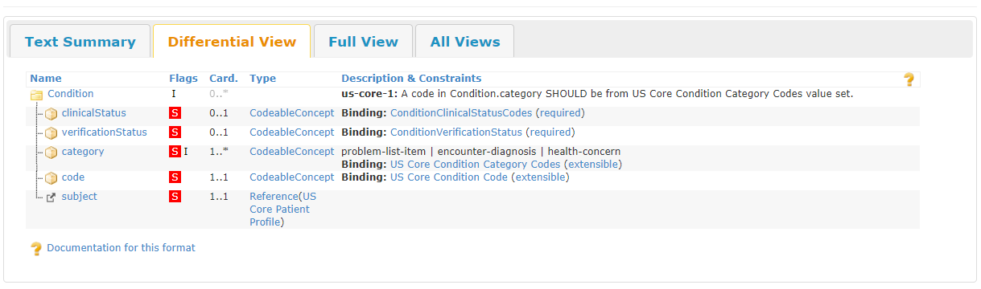
US Core Condition

Slide 17
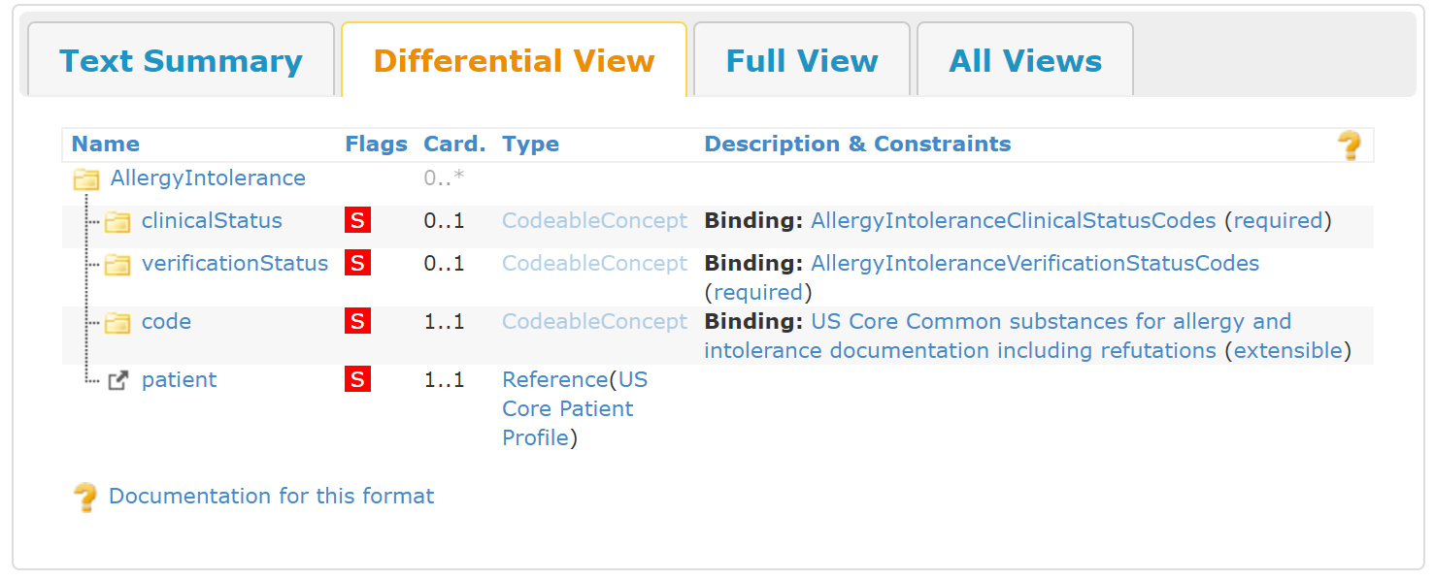
Profile Deep Dive – AllergyIntolerance
Prose
Mandatory Elements
Profile Specific Guidance
Formal View
Search
GET /AllergyIntolerance?patient=[id]
http://hl7.org/fhir/us/core/StructureDefinition-us-core-allergyintolerance.html

Slide 18
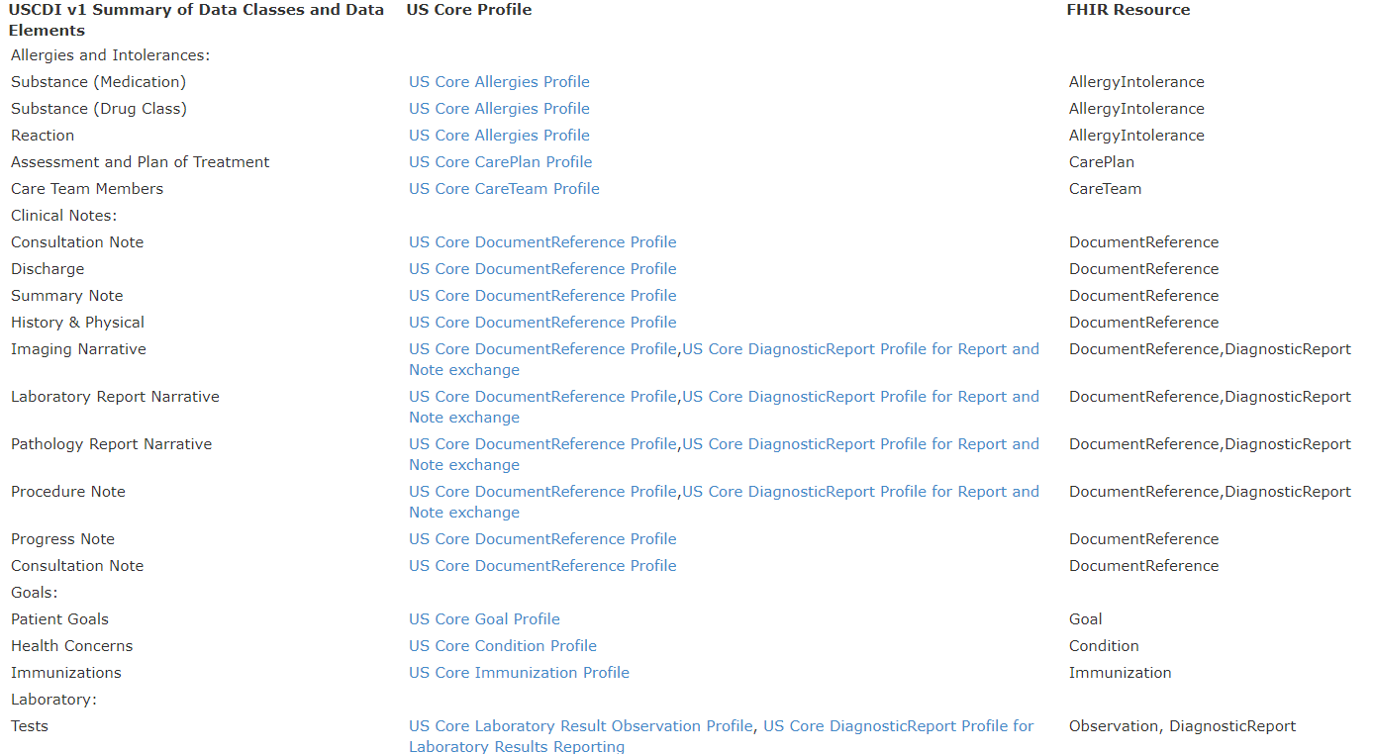
General Guidance: USCDI to US Core Profile Mapping
http://hl7.org/fhir/us/core/general-guidance.html
Notes:
FHIR RESOURCES

Slide 19
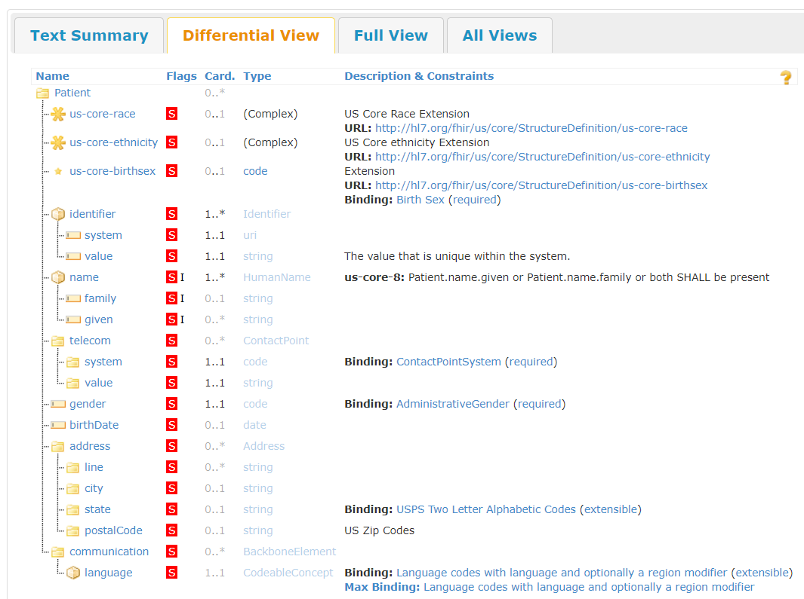
Profile – US Core Patient
Notes:
Complex Extension for race and ethnicity and birthsex, all must support for the use case of data query. Terminology binding for US Realm

Slide 20
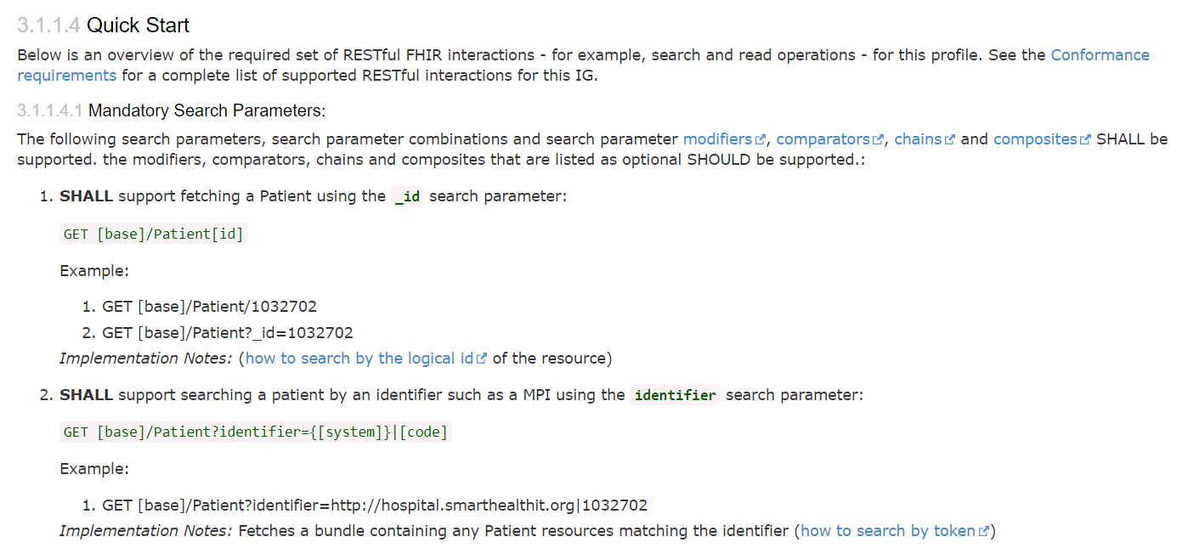
US Core Patient “Quick Start” Section
http://hl7.org/fhir/us/core/StructureDefinition-us-core-patient.html
Notes:
Quick Start and US Core is all about Search

Slide 21
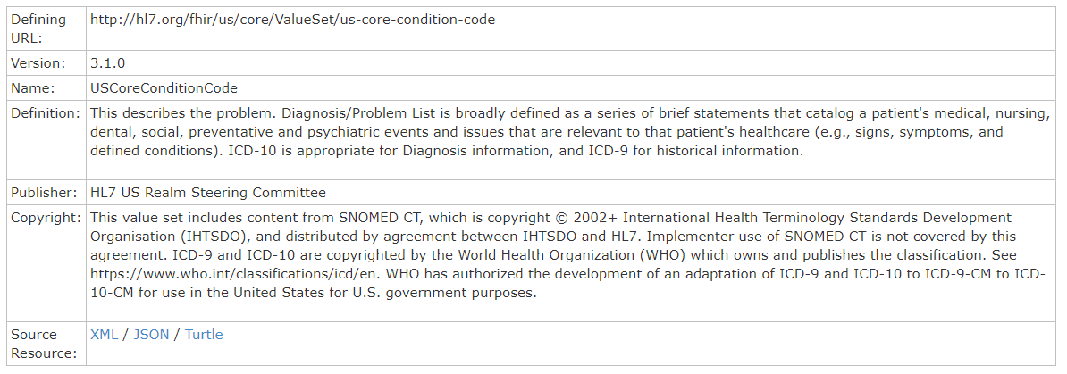
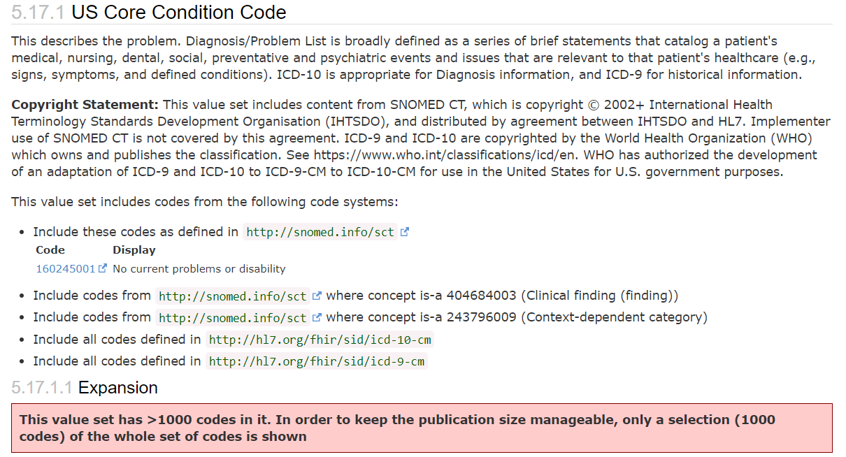
Value Sets - Problem Value Set
.compose: A definition of which codes are intended to be in the value set ("intension")

Slide 22
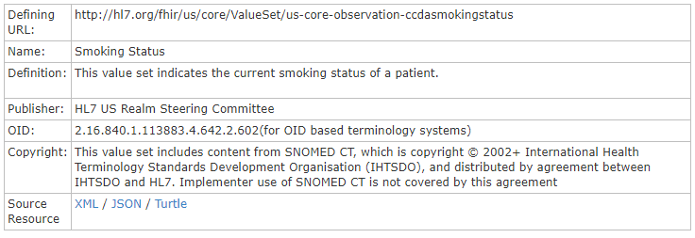
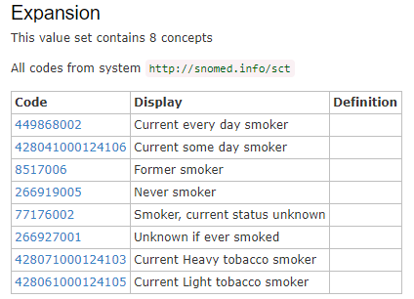
Value Sets - Smoking Status

Slide 23
Value Sets - Terminology
US Core Problem
Birth Sex
US Core Diagnosticreport Report And Note Codes
US Core Provider Role (NUCC)
US Core Smoking Status Observation Codes
US Core CareTeam Provider Roles
US Core DiagnosticReport Category
US Core Clinical Note Type
US Core DocumentReference Category
US Core Procedure Codes
Language codes with language and optionally a region modifier
US Core Observation Value Codes (SNOMED-CT)
US Core Diagnostic Report Laboratory Codes
Detailed Race
20+ Value Sets!
US Core Medication Codes (RxNorm)
US Core Smoking Status
OMB Race Categories
US Core Common substances for allergy and intolerance
US Core Narrative Status
US Core DocumentReference Type
OMB Ethnicity Categories
US Core Condition Category Codes
Detailed ethnicity
US Core Vaccine National Drug Codes (NDC)
US Core ICD-10-PCS Procedure Codes
US Core Provider Speciality (NUCC)
US Core Vaccine Administered Value Set (CVX)
US Core Status for Smoking Status Observation
USPS Two Letter Alphabetic Codes
US Core Encounter Type

Slide 24
CapabilityStatement (formerly know as Conformance)
US Core Server CapabilityStatement: This Section describes the expected capabilities of the US Core Server actor which is responsible for providing responses to the queries submitted by the US Core Requestors.
US Core Client CapabilityStatement: ​The Section describes the expected capabilities of the US Core Client which is responsible for creating and initiating the queries for information about an individual patient.

Slide 25
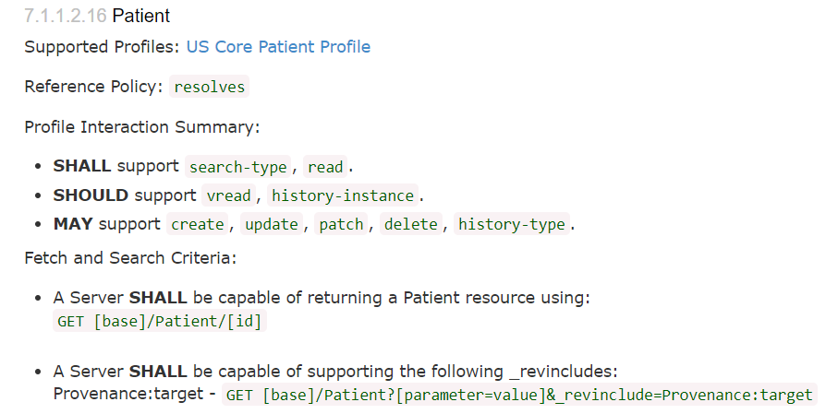
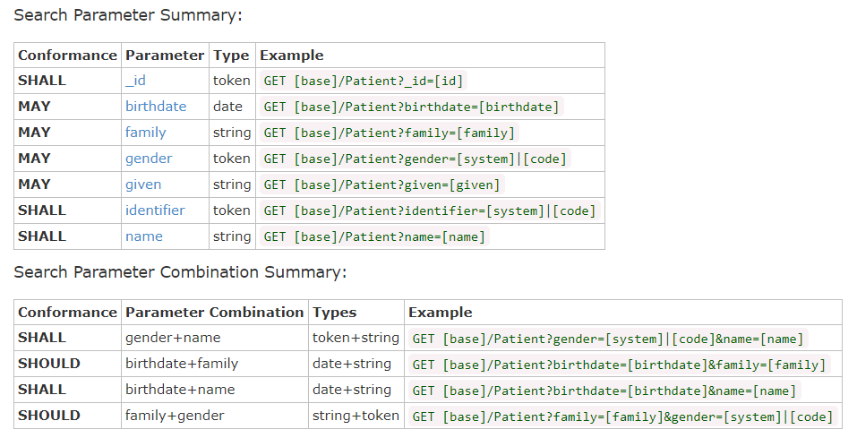
CapabilityStatement (formerly know as Conformance)
http://hl7.org/fhir/us/core/CapabilityStatement-us-core-server.html#patient

Slide 26
Extensions
US Core Race Extension
US Core ethnicity Extension
Email is a "direct" email
US Core Birth Sex Extension

Slide 27

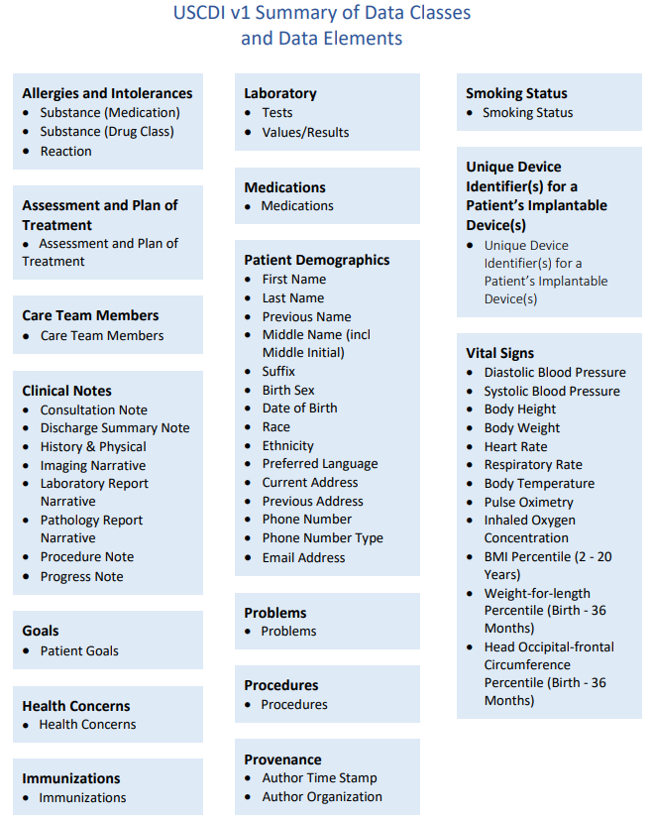
USCDI v1
https://www.healthit.gov/isa/sites/isa/files/2020-07/USCDI-Version-1-July-2020-Errata-Final.pdf

Slide 28
USCDI v1 = US CORE 3.1.0?
https://www.healthit.gov/isa/sites/isa/files/2020-07/USCDI-Version-1-July-2020-Errata-Final.pdf

Slide 29
US FHIR Core Errata Release
Key items
Missing USCDI vs Head Occipital-frontal Circumference Percentile (Birth - 36 months)
MedicationRequest can not be used for conveying "Patient-Reported medications"
Pediatric vitals should include referenced growth chart
US Core Procedure includes CDT in text, not Value Set
Fix ValueSet-us-core-procedure-icd10pcs
…about 45 more trackers. See HL7 JIRA filter
3.1.1 Errata Published
August 28
20
30
40
Notes:
Huge nod to Eric Haas. ONC/HL7 and the Federal Electronic Health Record Modernization (FEHRM)

Slide 30
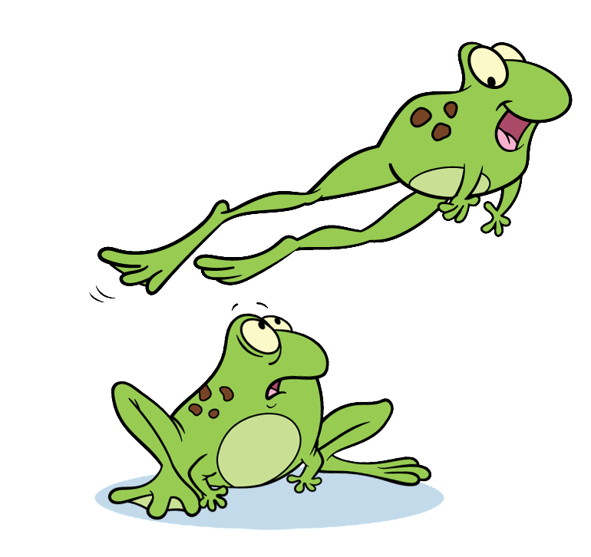
US CORE ≠ ONC USCDI
US CORE > ONC USCDI (HL7 new ballot)
US CORE < ONC USCDI (ONC new rule)
Continuous game of leapfrog!

Slide 31
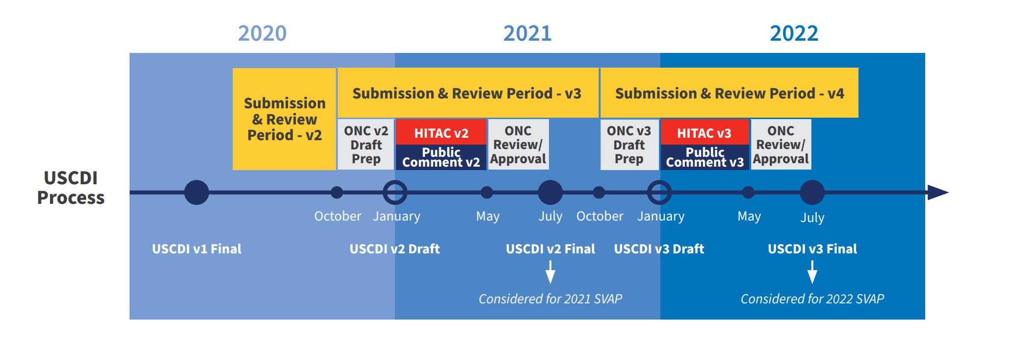
Standards Version Advancement Process (SVAP)
Using SVAP, certified health IT developers are permitted to voluntarily use a more advanced version of the standard(s) and implementation specification(s) approved by the National Coordinator
https://www.healthit.gov/isa/standards-version-advancement-process

Slide 32
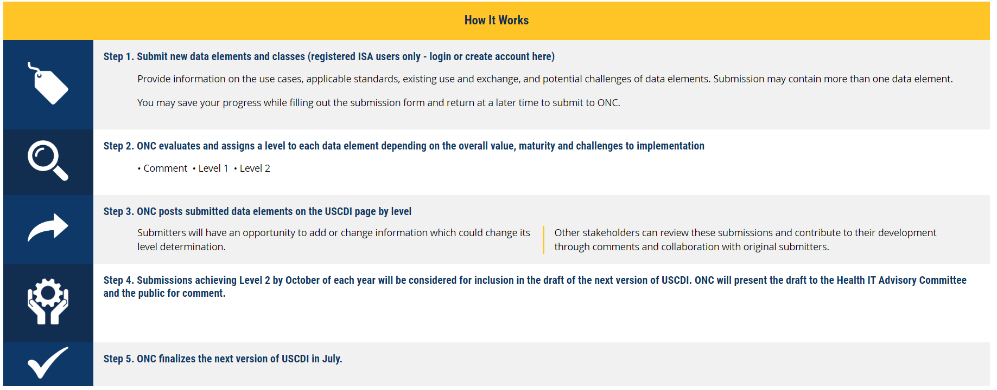
USCDI ONDEC (ONC Data Element and Class) Submission System
https://www.healthit.gov/isa/ONDEC

Slide 33
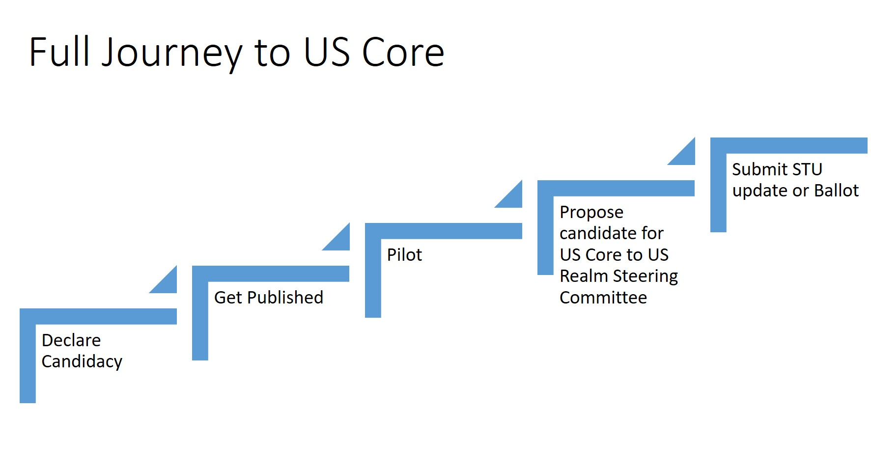

Slide 34

Argonaut and other communities
…or just create a new -->

Slide 35
US FHIR Core ballot January 2021 will reconcile any issues logged in 2020
US FHIR Core will ballot every January with new USCDI elements starting in 2022
This ballot will reflect HL7 update requests (JIRA) and response to USCDI v+1
Connect-a-thons/pilot testing precede US FHIR Core Update Ballot
Jan
May
July
Sept
Dec
2020
USCDI
Final v1
US FHIR Core 3.1.1 Published
Industry testing/piloting prior to and feeding into US FHIR Core Ballot
2021
USCDI
Draft v2
Comment Period
Review and Response
USCDI
Final v2
SVAP USCDI Final v2
US FHIR Core Ballot
Publication!
*Early Ballot?
SVAP US Core
Jan 2021 Pub
Ballot Resolution
Industry testing/piloting prior to and feeding into US FHIR Core Updates Ballot – Not Limited to USCDI
(Continuous build updated)
2022
USCDI
Draft v3
Comment Period
Review and Response
USCDI
Final v3
SVAP USCDI Final v3
Publication!
*Early Ballot?
US FHIR Core Ballot
Ballot Resolution
SVAP US Core U*F2 Publish
Industry testing/piloting prior to and feeding into US FHIR Core Updates Ballot – Not Limited to USCDI
(Continuous build updated)

Slide 36
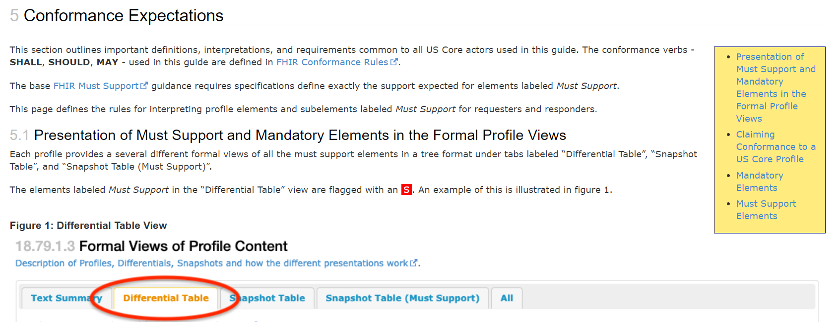
US Core 3.2.0 Ballot
Resolved 90+ open trackers.
Added brand new page Conformance expectations page to clarify Must Support and other details.
Adding clear guidance on supporting the structure (profile) vs the API (structure + interaction)

Slide 37
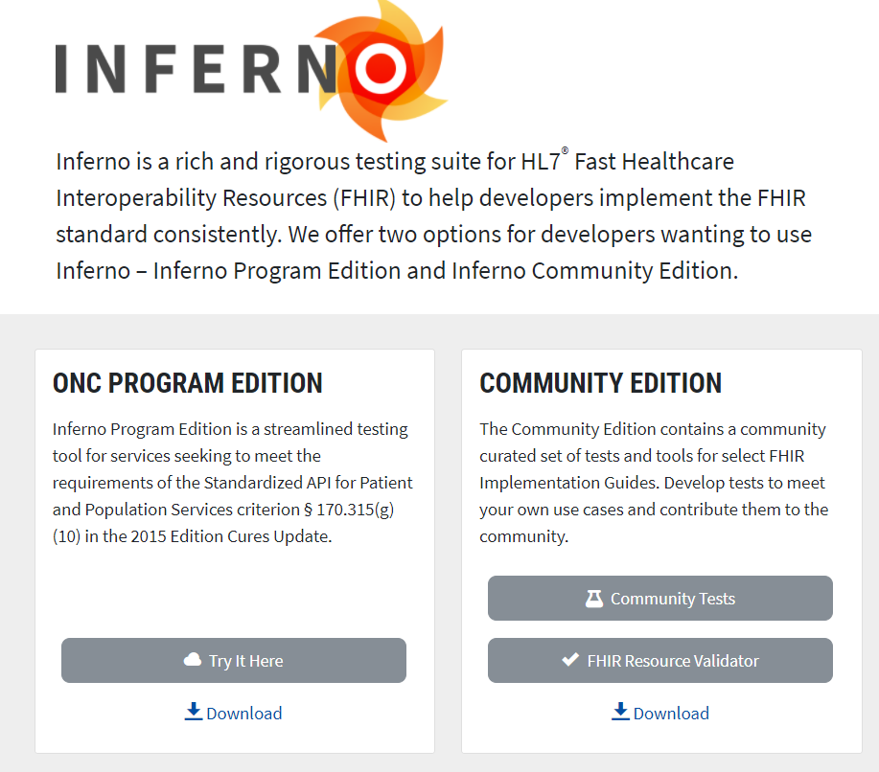
https://inferno.healthit.gov/
Notes:
CONFORMANCE!

Slide 38
https://inferno.healthit.gov/

Slide 39
https://inferno.healthit.gov/

Slide 40
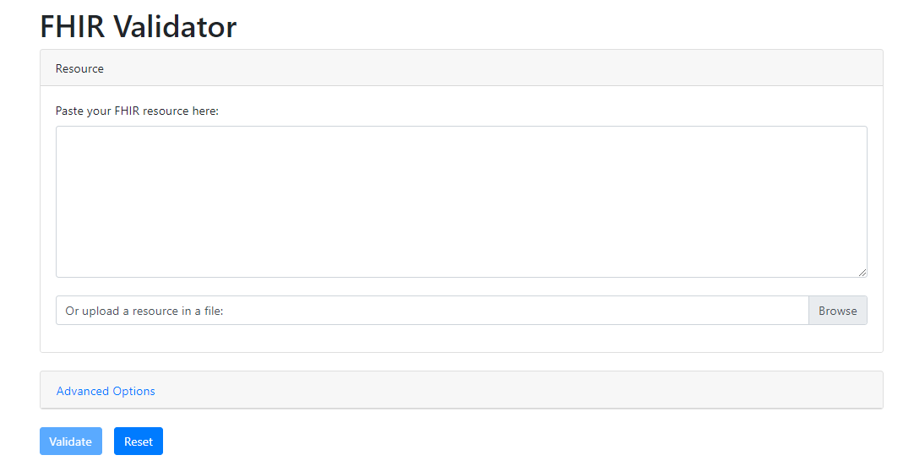
https://inferno.healthit.gov/validator/

Slide 41
Future of Argonaut + US FHIR Core
Encourage everyone to use US FHIR Core rather than writing their own FHIR STU3 guide, or FHIR R4 guide.
Argonaut projects for 2021
FHIR Write - Currently, very little guidance is provided on writing and updating data in the context of USCDI Core profiles in FHIR. Provide a standard approach in FHIR, and propose to US Core.
Subscriptions - Promote adoption of the Subscription framework (R4 & R5). Discuss implementation questions / issues / challenges. Build out testing and reporting
‘others’ under consideration:
Native App Security best practices
Electronic Health Information (EHI) Export
SMART Scheduling links
USCDI V2 design and testing…

Slide 42
Interop thought experiment

Slide 43
Data vs Narrative
Tug of war

Slide 44
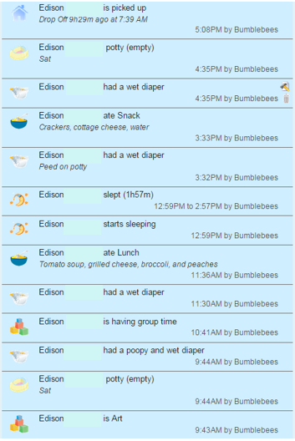

Data

Slide 45
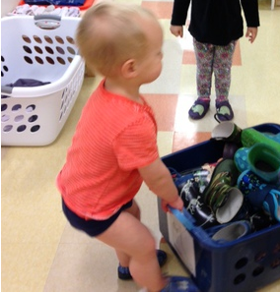
Narrative – ‘the shoe bin’
Today, after returning from our walk Edison told us he wanted to put the boot bin away. I told him he could help if he got undressed, but he dawdled. I reminded him a couple of times if he wanted to put the boot bin away he would need to get undressed. He chose to watch other children and roll on the floor, so eventually I let him know that I was going to invite other children to put it away. He got very upset and actually cried :( We have seen similar experimental behaviors from Edison so we are working with Edison to link his actions to the consequences. Edison remembers things from the past and so we hark back onto those moments to help explain why he should cooperate or do as we ask.

Slide 46
Other School - Nothing

Slide 47

Don’t lose the story!

Slide 48
Clinical Notes
Common Clinical Notes Set
Consultation Note (11488-4)
Discharge Summary (18842-5)
History & Physical Note (34117-2)
Procedures Note (28570-0)
Progress Note (11506-3)
and three DiagnosticReport categories which systems should support.
Cardiology (LP29708-2)
Pathology (LP7839-6)
Radiology (LP29684-5)
Starter Set for testing and design - the value set will is not restricted

Slide 49
Anticipated Note Formats
Mixed document: structured FHIR resources, and narrative
RTF or PDF or .doc
Text or XHTML
Increasing
Level of Complexity

Slide 50

Participation
Review existing designs and comment using HL7 JIRA
Zulip Chat Channel
Argonaut
Da Vinci
Argonaut Confluence Page
…or whatever is your favorite IG!
Contacts
Gino Canessa
Dan Gottlieb
Eric Haas
Josh Mandel
Brett Marquard

